Slide 1
Presentation 1
Arduino project

Slide 2
What is arduino ?
Circuit components is a group of dead resistors and capacitors interacting by voltages and currents
We need to add some intelligence to the circuit
We need to add a component that makes desision and act as the brain of the circuit
Normally a micro controller is used
The microcontroller used here iS Arduino

Slide 3
Why Arduino?
Arduino is 1)Inexpensive
2) simple
3)open source hard were
4)open sourse soft were

Slide 4
PROJECT ONE ☺
Controlling a group of LEDs Using arduino
It is a design of a group of leads in which 1st led is on then 2nd ,3rd .....6th and then it goes back 6th ,5th ,4th .........1st

Slide 5

The code on the arduino ☺

Slide 6
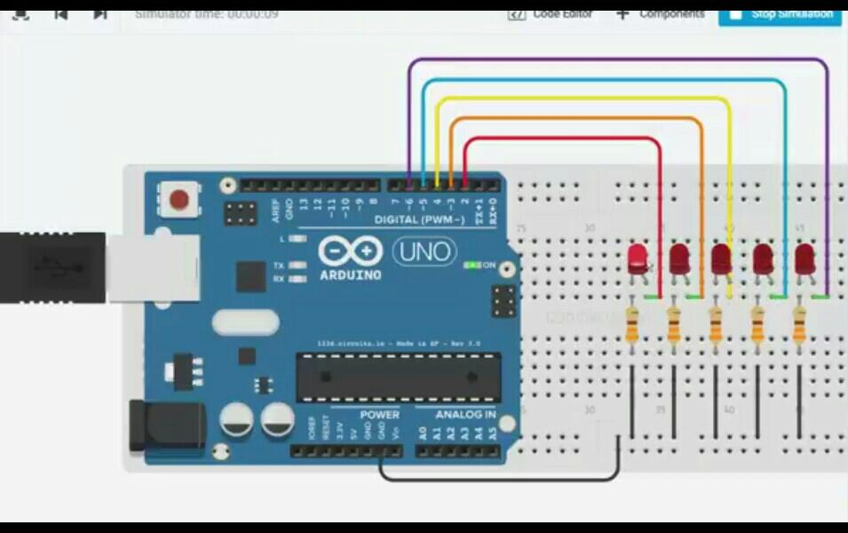
Simulation of the project on circuits.io
1st led is on

Slide 7

2nd led is on
Then the sequence will be 2nd ,3rd 4th ,5th ,6th

Slide 8
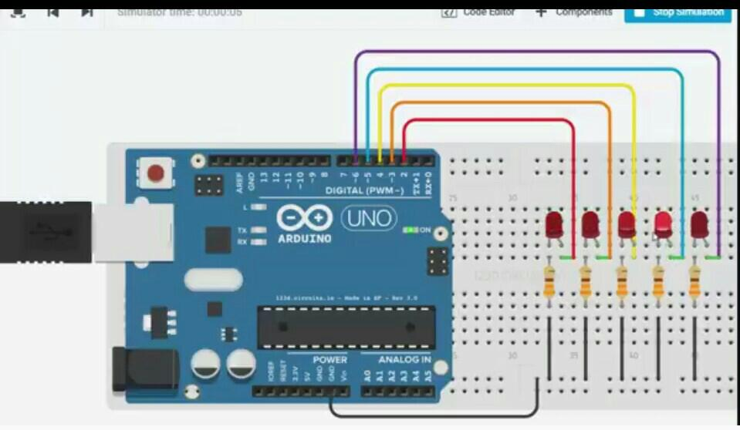
Then it will go back 6th ,5th ,4th 3rd ,2nd ,1st
And it will loop again ☺

